Slide 1
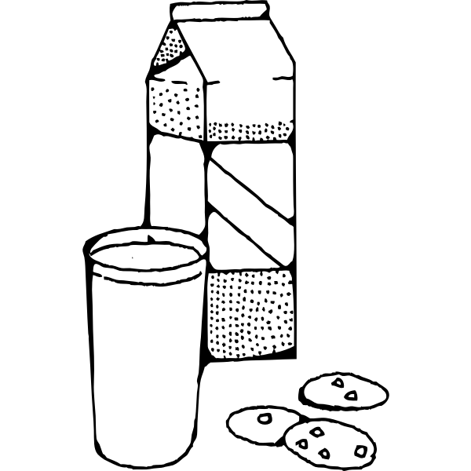
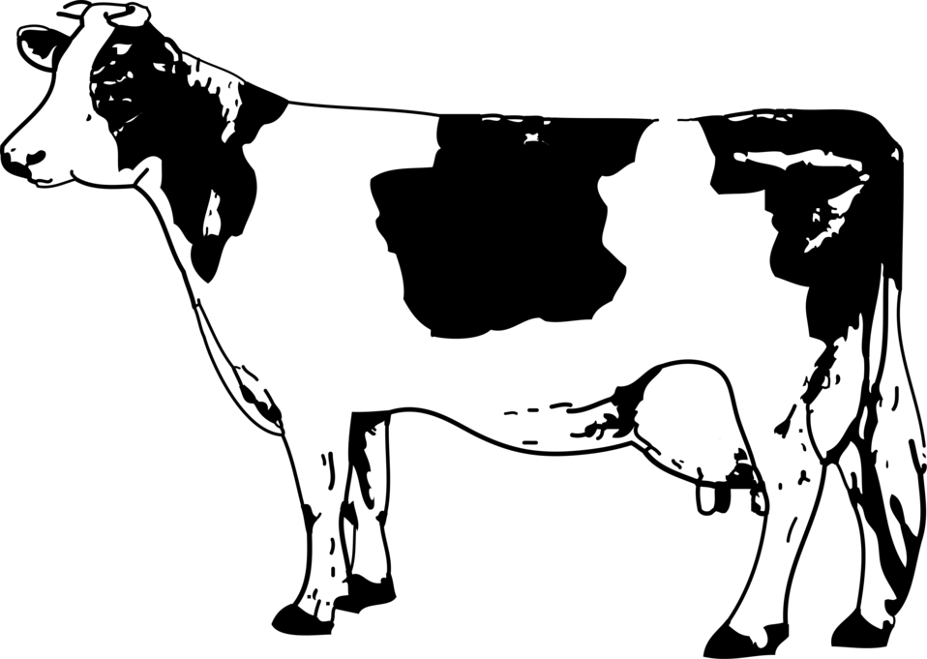
The Dairy Bar
Lunch Specialties
Snacks and Sides
We serve the freshest housemade cheeses, ice cream, and milk from our herd of happy Jersey cows.
Patty Melt | $7.99
CheeseBurger | $7.99
Grilled Cheese | $5.99
Truffle mac ‘n cheese | $8.99
Lobster mac ‘n cheese | $15.99
Vegan mac ‘n cheez | $15.99
Caprese salad | $11.99
Haloumi salad | $11.99
Fries | $4
Sweet Potato Fries | $4
Side salad | $5
Cheese curds | $7
Fondue | $9
Milk & Cookies | $9
Signature Shakes
Vanilla, strawberry, chocolate | $3.99
Summer fruit | $5.99
Fruits of the Forest | $5.99
Cookies & Cream | $5.99
Make it a combo!
Save $4 when you combine any specialty dish with a side and shake.

